Slide 1
HSC Exam Considerations
Studies of Religion

Slide 2
Always remember the aspects of religion, and the adherents!
What is the ultimate purpose? Religions seek to connect adherents to the transcendent (e.g. God, enlightenment, etc)
How does the religion provide meaning? Religious worldviews seek to make sense of the world (e.g. the Four Noble Truths, we are made in the image and likeness of God, Allah has a will for all things, etc)
Religions are ‘living’ and ‘dynamic’ because the adherents follow them and shape them. Remember the diagram…

Slide 3
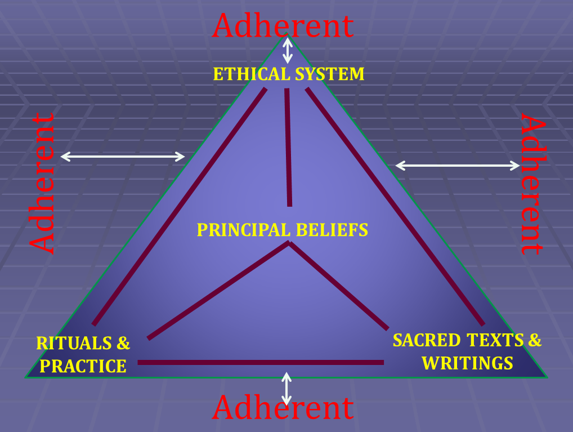

Slide 4
DIRECTIVE TERMS
KNOW the Board of Studies Directive Terms
Use appropriate words in your response to make sure you are addressing the directive term.

Slide 5
To indicate additional points
In addition
Again
Also
Besides
Finally
Further
Furthermore
Moreover
Next
D
E
S
C
R
I
B
E
O
U
T
L
I
N
E

Slide 6
To indicate examples
D
E
M
O
N
S
T
R
A
T
E
For example
For instance
To illustrate
In other words
By way of illustration
In this case
Specifically
In particular

Slide 7
To indicate cause and effect
Accordingly
As a result
Hence
Consequently
Subsequently
Otherwise
Therefore
Thus
E
X
P
L
A
I
N

Slide 8
To indicate significance
Profound
Strong
Integral to
Important
Great
Extreme
Pronounced
Abundant
Limited
Inconsistent
E
V
A
L
U
A
T
E

Slide 9
To indicate consequence of an argument
Therefore
Consequently
Accordingly
Hence
As a consequence
Otherwise
Thereupon
Directly
As a result
A
N
A
L
Y
S
I
S

