Slide 1
Responding to Sections II & III in the HSC

Slide 2
When answering questions
Always read the rubric
This is what the markers are looking for!
Identify the directive term
This will determine what you need to do with the information
Circle the key words
Always use the language of the question in your response
Re-write the question in your own words
Prove to yourself that you understand the question
Always remember the aspects of religion, and the adherents! Religions are ‘living’ and ‘dynamic’ because the adherents follow them and shape them. Remember the diagram…

Slide 3
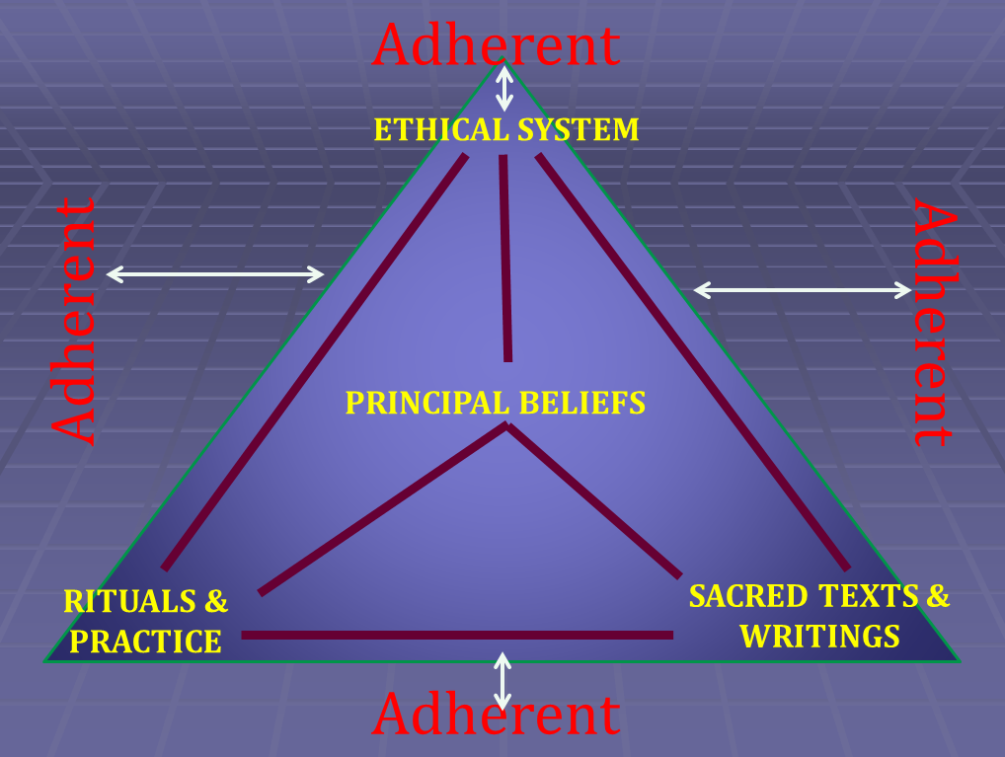

Slide 4
SECTION II

Slide 5
Notes on Section II
Most people lose most of their marks here
People don’t give enough relevant information
You must be really specific and straight to the point
Don’t waffle on! You don’t have time or space.
Consider the mark allocation per question
e.g. 3-mark questions don’t require one page of writing
Give specific examples
Always be really specific – this is where many marks are lost
Write about the whole tradition
Where possible, discuss variants, and always refer to aspects of religion

Slide 6
2009 Section II
Question I – Buddhism (15 marks)
Describe ONE Buddhist ethical teaching in ONE of the following areas: (4 marks)
Bioethics
Environmental ethics
Sexual ethics
(b) Explain how ONE of the following practices expresses the beliefs of Buddhism: (5 marks)
Pilgrimage
Temple Puja
Wesak
(c) Analyse the impact on Buddhism of ONE significant person or school of thought (6 marks)

Slide 7
2009 Section II
Question 2 – Christianity (15 marks)
Outline ONE significant practice within Christianity drawn from the following: (4 marks)
Baptism
Marriage Ceremony
Saturday/Sunday Worship
(b) Explain how Christian ethical teachings, in ONE of the following areas, reflect Christian beliefs (5 marks)
Bioethics
Environmental ethics
Sexual ethics
(c) Evaluate the contribution of ONE significant person or school of thought, other than Jesus, to the development and expression of Christianity (6 marks)

Slide 8
2010 Section II
Question 4 – Islam (15 marks)
(i) Outline ONE significant practice within Islam drawn from the following: (3 marks)
Friday prayer at the mosque
Funeral ceremony
Hajj
Link the chosen significant practice from part (a) (i) to beliefs of Islam (4 marks)
Analyse the influence of ethical teaching on the life of adherents in ONE of the following areas: (8 marks)
Bioethics
Environmental ethics
Sexual ethics

Slide 9
2011 Section II
Question 2 – Christianity (15 marks)
Outline the contribution of ONE significant person or school of thought other than Jesus to the development and expression of Christianity (3 marks)
Summarise the impact of the significant person or school of thought in part (a) (4 marks)
“Christianity has always sought to reconnect the faith to its founding roots”
To what extent does the statement apply to the impact of the significant person or school of thought chosen in part (a)? (8 marks)

Slide 10
SECTION III

Slide 11
Notes on Section III
Always read the Rubric
The marking criteria is always based on these. It will tell you exactly what the markers are looking for.
Plan your response
Decide on a thesis (your ultimate answer to the question)
List the idea for each paragraph
Write about the whole tradition
Where possible, discuss variants, and always refer to aspects of religion

Slide 12
2009 Section III
Question 2 – Christianity (20 marks)
Now it came to pass, as he sat at the table with them, that he took the bread, blessed it and broke it, and gave it to them. Then their eyes were opened and they knew him; and he vanished from their sight. And they said to one another, ‘Did not our heart burn within us while he talked with us on the road, and while he opened the Scriptures to us?’
Luke 24:30-32, New King James Bible
With reference to Luke’s post-resurrection account in the quotation, assess Christianity as a living religious tradition in the life of its adherents.

Slide 13
2010 Section III
Question 4 – Islam (20 marks)
In the name of God, Most Gracious, Most Merciful,
… to You alone do we turn for help.
Guide us along the straight path
Qur’an 1:2-6
To what extent does this quotation express the distinctive Islamic answer to the enduring questions of human existence?

Slide 14
2010 Section III
Question 1 – Buddhism (20 marks)
Buddhists just go simply.
To what extent does this statement illustrate the influence of Buddhism on individuals and the Buddhist community?

Slide 15
2011 Section III
Question 4 – Islam (20 marks)
Some religion emphasise justice, while other emphasise compassion
Discuss this statement in relation to Islam as a living religious tradition

